Slide 1
Palindromic Substrings
Palindromic: 回文
Eg. aba, abcba, …
Problems:
Find the longest palindromic substring of a string;
Compute the total number of palindromic substrings of a string
(Leetcode: 647)
…

Slide 2

1 Brute Force
Find every substring of a given string. -->> O($n^{2}$)
Judge if this substring is palindromic. -->> O(n)
Time complexity: O($n^{3}$)

Slide 3
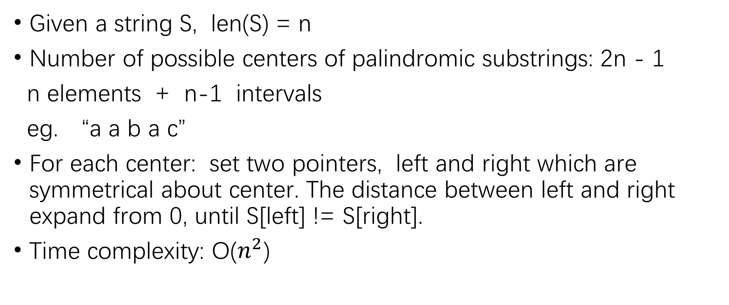
2 Expand around center
Given a string S, len(S) = n
Number of possible centers of palindromic substrings: 2n - 1
n elements + n-1 intervals
eg. “a a b a c”
For each center: set two pointers, left and right which are symmetrical about center. The distance between left and right expand from 0, until S[left] != S[right].
Time complexity: O($n^{2}$)

Slide 4
3 Manacher algorithm. O(n) time !!
Given a string S: a a b a c
1. Transform S to T:
S: a a a b a
T: # a # a # a # b # a #
Add a special symbol between every two elements and the start and the end of the string.
The special symbol can’t appear in the original string S!

Slide 5
2. Allocate an array Len(), which has the same length as T.
0 1 2 3 4 5 6 7 8 9 10
T:
Len():
Len[i]: The distance between T[i] and the rightmost element of the longest palindromic substring which has T[i] as center.
Eg. Len[7]: the longest palindromic substring with T[7] as center is:
T[4] ~ T[10]: #a#b#a#.
The distance between the last # and T[7](b) is: 10 – 7 = 3
#
a
#
a
#
a
#
b
#
a
#
0
1
2
3
2
1
0
3
0
1
0

Slide 6
What is len() used for ?
Len[i] == the length of longest palindromic substring of the original string S, with T[i] as its center.
S: a a a b a
T:
Len():
#
a
#
a
#
a
#
b
#
a
#
0
1
2
3
2
1
0
3
0
1
0

Slide 7
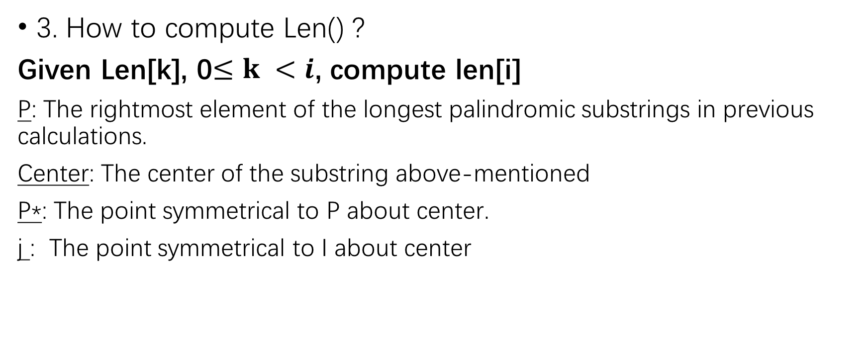
3. How to compute Len() ?
Given Len[k], 0$≤k <i$, compute len[i]
P: The rightmost element of the longest palindromic substrings in previous calculations.
Center: The center of the substring above-mentioned
P*: The point symmetrical to P about center.
j : The point symmetrical to I about center
P*
j
center
i
P

Slide 8

i $≤$ P
i $>$ P
Len[j]
p+1
P*
j
center
i
P
Focus on len[j]:
If len[j] <= p – i:
len[i] = len[j]
Else:
len[i] is at least p - i, so initiate len[i] as p - i
From p, check if it is palindromic one by one. (T[p + 1] == T[2i – (p + 1)])
P*
center
P
i

Slide 9
Thank you!

